Slide 1
SECURE DATA HIDING IN IMAGES USING STEGANOGRAPHY
CAPSTONE PROJECT
Presented By: Vansh Pillai
Student Name : Vansh Pillai
College Name & Department :
SIES Graduate School of Technology , Computer Engineering.

Slide 2
OUTLINE
Problem Statement
Technology used
Wow factor
End users
Result
Conclusion
Git-hub Link
Future scope

Slide 3
Problem Statement
In an era where digital communication privacy is increasingly important, there is a need for secure methods to transmit confidential messages. Steganography, the practice of concealing information within seemingly innocent carriers, offers a solution by hiding messages within digital images without visibly altering their appearance.

Slide 4
Technology used
Programming Language: Python (Python IDLE 3.12)
Required Libraries:
OpenCV (cv2)
NumPy
Hashlib
OS
String
Input/Output: Command-line interface

Slide 5
Wow factors
Message Hiding
A user wants to hide a confidential message in an image
They provide an image file, message, and password
The system produces an encrypted image file
Message Retrieval
A user receives an encrypted image
They provide the correct password
The system reveals the hidden message
Unauthorized Access Prevention
An unauthorized user attempts to extract the message
They provide an incorrect password
The system denies access to the hidden message

Slide 6
End users
1. Privacy-Conscious Individuals
2. Business Professionals
Corporate executives sharing confidential business strategies
Legal professionals handling sensitive client information
3. Security Professionals
Cybersecurity experts testing secure communication methods
IT professionals implementing secure data transfer solutions
4. Educational Sector
Computer science students learning about cryptography

Slide 7
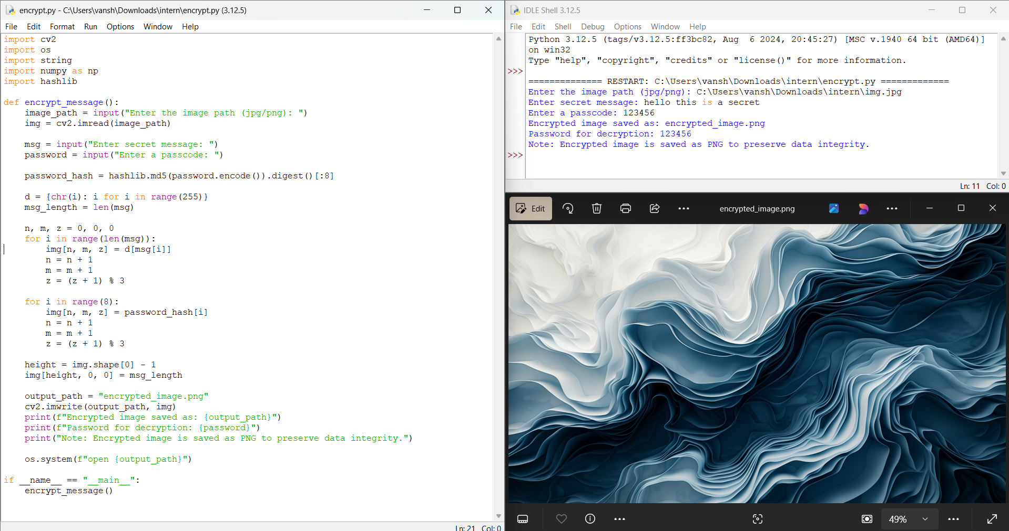
Results

Slide 8
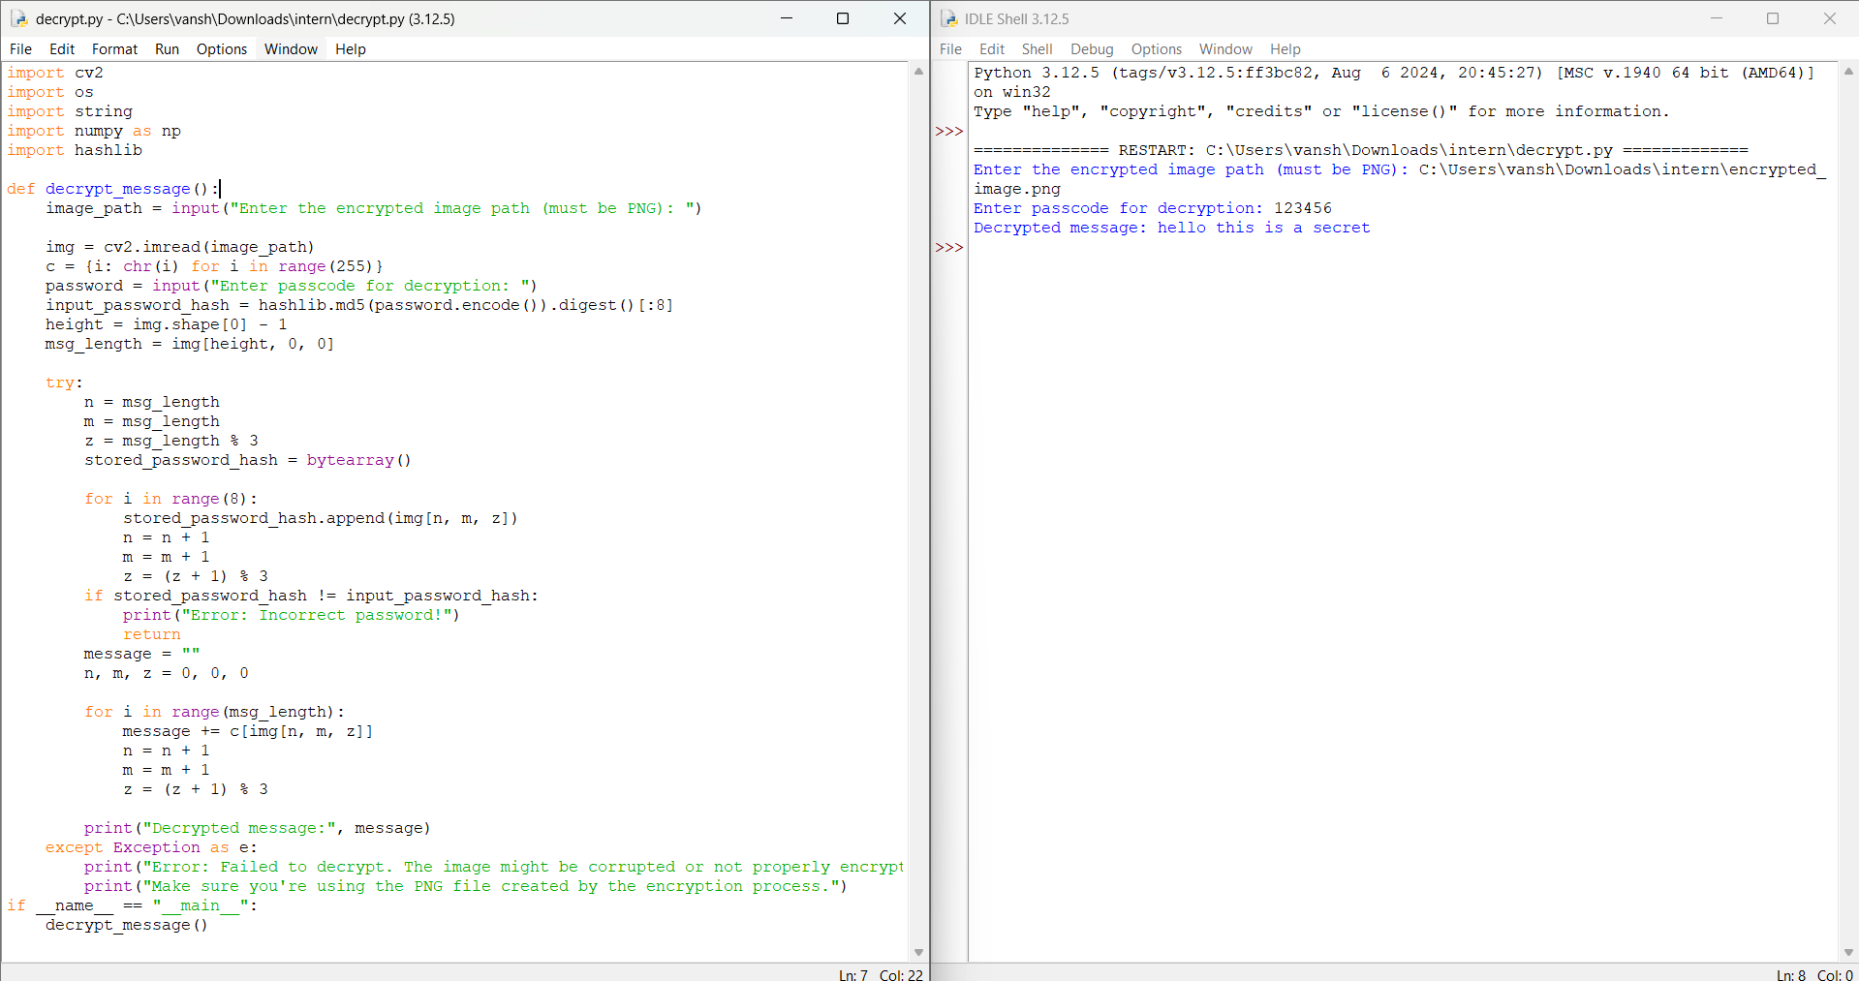
Results

Slide 9
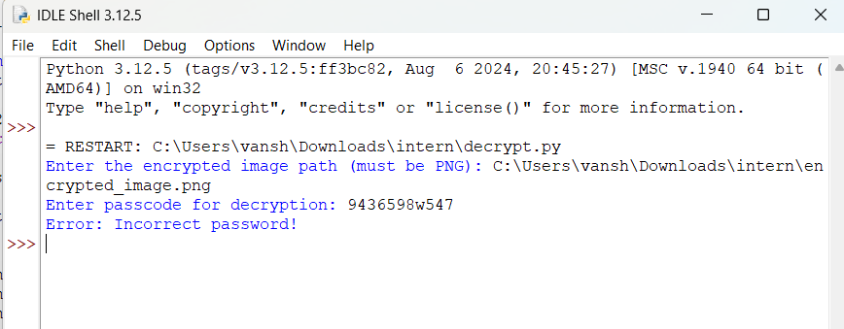
Results
INCORRECT PASSWORD CHECK

Slide 10
Conclusion
The implemented image steganography system successfully addresses the growing need for secure and private digital communication.
By leveraging the principles of digital image processing and cryptography, the system provides a robust solution for hiding confidential messages within ordinary image files while ensuring data security through password protection.
Key Achievements
Technical Implementation
Successfully developed a dual-component system (encryption and decryption modules)
Implemented lossless data hiding using PNG format
Integrated password-based security using hash verification
Created error handling mechanisms for various scenarios
Maintained image quality while embedding data

Slide 11
GitHub Link
https://github.com/vansh6904/Stagnography-Project.git

Slide 12
Future scope(optional)
Graphical user interface development
Support for additional file formats
Enhanced encryption algorithms
Batch processing capabilities
Integration with existing communication systems

Slide 13
THANK YOU

